Slide 1

CultureCoin: Turning Exploration into Reward Gamifying local culture for the next generation of explorers
What if exploring your neighborhood could earn you
more than memories?

Slide 2

01
Introduction

Slide 3
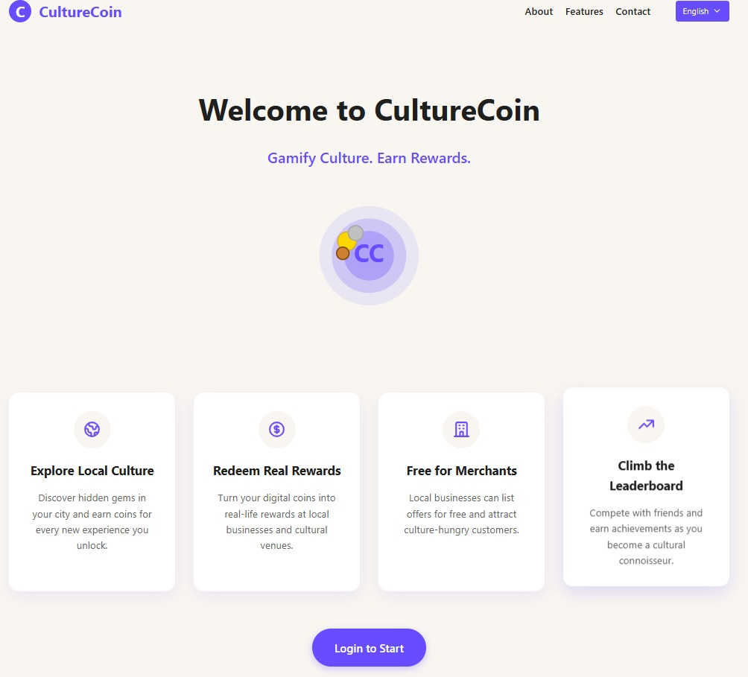

What is CultureCoin?
CultureCoin is a tech-driven platform supporting local cultural businesses.
Uses machine learning to enhance user experience and business insights.
Rewards users with CultureCoins (CC) for exploring and supporting cultural spots.
Promotes a cycle of discovery, engagement, and community growth.
Aims to turn cities into vibrant cultural hubs through gamified incentives.

Slide 4
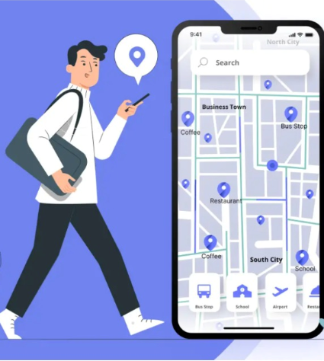

Purpose of the project
The primary purpose of CultureCoin:
Strengthen the ties between consumers and local cultural businesses.
Rewarding users
The project aims to sustain cultural heritage.
Promote a thriving local economy

Slide 5
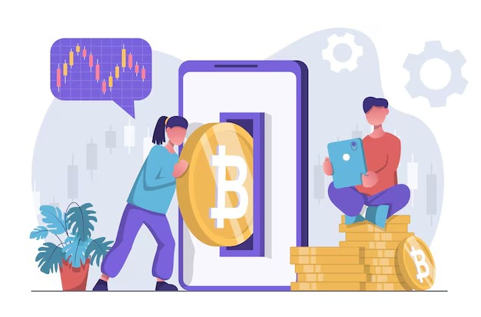

Vision
CultureCoin isn’t just an app—it’s a movement.
We aim to build digital bridges that connect people with their roots and bring recognition to the unseen heroes of cultural heritage.
By making cultural participation measurable and rewarding, we transform every citizen into a cultural ambassador.

Slide 6

02
Problem & Solution

Slide 7


Problem Statement
Small and traditional cultural businesses face increasing pressure from large corporations and online giants in the modern digital economy. These local establishments often:
Lack digital visibility
Struggle with customer retention
Cannot afford high-cost marketing strategies
Get overshadowed in online listings
At the same time, urban lifestyles have distanced people from engaging with their local culture. There’s a lack of motivation to explore one’s city or town in meaningful, culturally rooted ways

Slide 8

Our Solution CultureCoin introduces a smart, fun, and intuitive way to bring people back to their roots while helping local businesses grow. By rewarding users with digital tokens (CC) for simply participating in their local culture, we:
Build consistent footfall for small businesses
Encourage people to discover hidden cultural gems
Provide a digital ecosystem to track, reward, and re-engage consumers
Help local businesses collect insights to optimize their services
Offer educational elements about local heritage through gamification
Strengthen community bonding through shared cultural experiences
Empower merchants with low-cost marketing and consumer analytics tools
Increase digital inclusion by onboarding traditionally offline merchants
Encourage cultural preservation through rewards-based storytelling and exploration
Promote sustainability by reducing dependency on high-cost ads or third-party delivery platforms

Slide 9
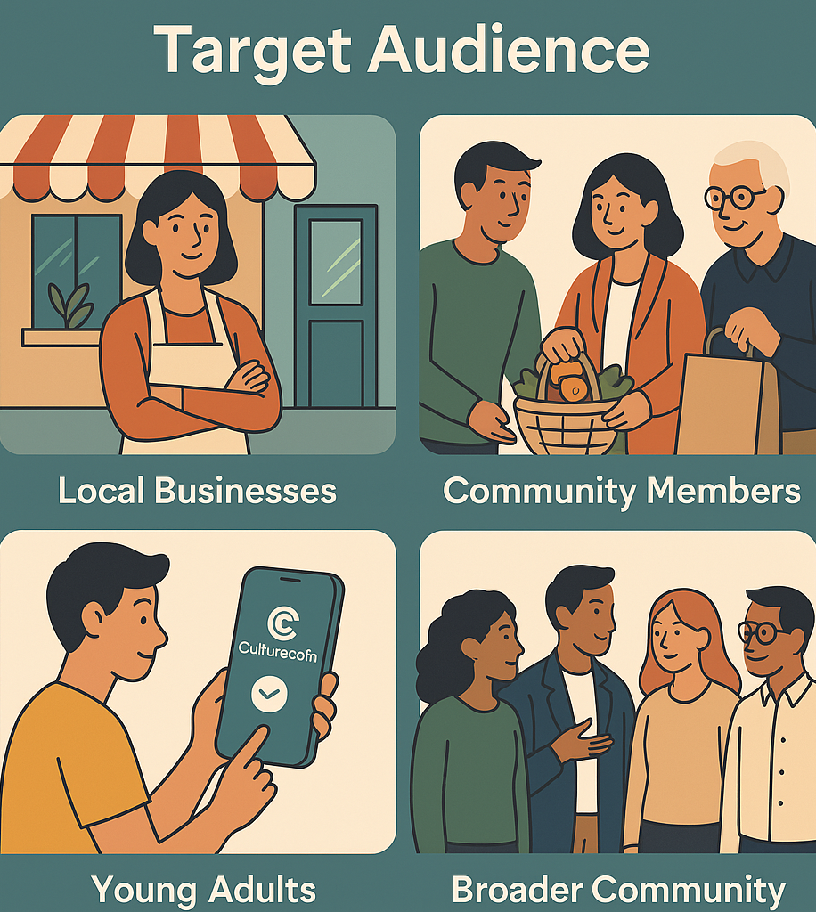

Target Audience
Explorers: Students, travelers, working professionals, and culture enthusiasts looking to earn rewards by exploring their neighborhood.
Merchants: Artisans, family-run shops, traditional eateries, local event organizers, and all small businesses that represent cultural heritage.

Slide 10

03
How it Works?

Slide 11

1. Onboarding
2. Explorer Experience
The user downloads the CultureCoin app or visits the website.
They choose their role: Explorer or Merchant.
Login is simple using email or social platform
Homepage: Personalized dashboard with recommended places and community news.
Explore Map: Toggle between list view and an interactive map showing cultural hotspots and registered merchants.
Reward: Redeeming and transferring tokens
Leaderboard: Shows the ranking of top explorers of the platform.
3. Merchant Experience
Homepage: A snapshot of customer activity and engagement.
Sales Insight: ML-powered suggestions for peak hours, customer trends, and demographics.
Listing: Rewards allocation and removal based on personal preference.

Slide 12


Technology Stack
Backend: Python-based backend with integrated machine learning for predictive insights, trend analysis, and personalized recommendations.
Frontend: Built with Mobile First designs translated into a mobile/web-responsive UI. Elegant glow palettes evoke a cultural feel.
Data Layer: Firebase for dynamic data syncing and real-time updates.

Slide 13
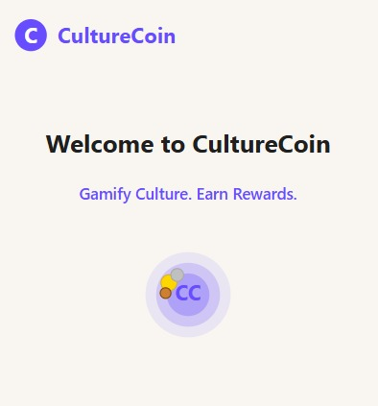
Unique Features
Native language: The User can use a language they are comfortable with.
Cultural Trail Challenges: Users can participate in seasonal challenges to earn bonus CC.
Explorer Badges: Gamified experiences that reward consistent engagement.
Community Stories: Explorers and Merchants can share their cultural stories.
Instant Reward System: QR codes for point-of-sale reward redemption.

Slide 14
03
Competitive Differentiation

Slide 15

Market Opportunities
Indian Loyalty Program Market: $5.37B in 2024, estimated to hit $8.02B by 2028.
Rise of Hyperlocal Platforms: Millennials and Gen Z prefer community-driven businesses.
Cultural Tourism Growth: 37% of young travelers prefer cultural experiences over traditional tourism.

Slide 16
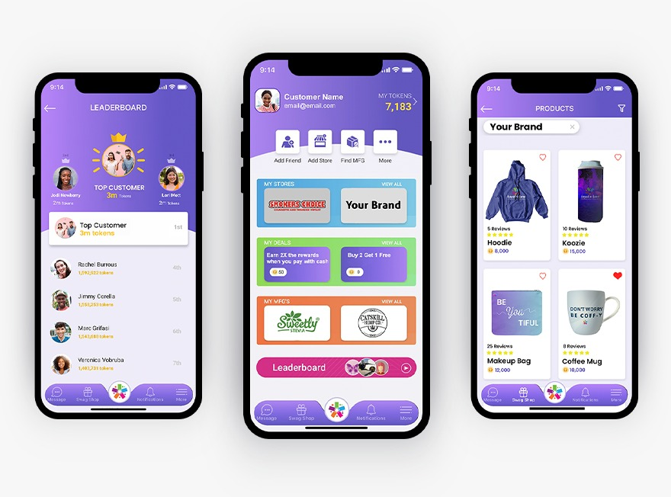
While there are apps for loyalty and discovery, none combine:
Cultural depth
Token-based reward systems
Dual dashboard functionality for users and merchants
Machine learning-enhanced personalization
Fully gamified experiences
This makes CultureCoin a truly unique platform.

Slide 17
Competition comparison
Startup | Focus Area | Tech Use | Community centric | Token driven
Monet | Loyalty flexibility via blockchain | AI & Blockchain | NO | YES
Rewardola | Local biz Reward Apps | App Based | YES | NO
LoyalCoin | Universal points Exchange | Crypto Wallet | NO | YES
CultureCoin | Culture + Rewards | ML,Web, Mobile | YES | YES

Slide 18

SWOT Analysis
Strengths:
Weaknesses:
Unique cultural value proposition
Community-based growth model
Double-sided platform (Merchants and Explorers)
Early mover advantage in the cultural token space
Seamless tech integration with ML insights
Requires merchant and user onboarding efforts
Limited initial geographic reach
Dependency on reliable location and merchant data
Opportunities:
Threats:
Rising trend in experiential tourism and hyperlocal discovery
Expanding digital inclusion for small businesses
Strategic partnerships with cultural boards and travel platforms
Potential government support for culture-preserving initiatives
Competition from general-purpose loyalty apps
Merchant hesitance in adopting tech
Economic downturns affecting discretionary spending
Tech scalability challenges in diverse regions

Slide 19
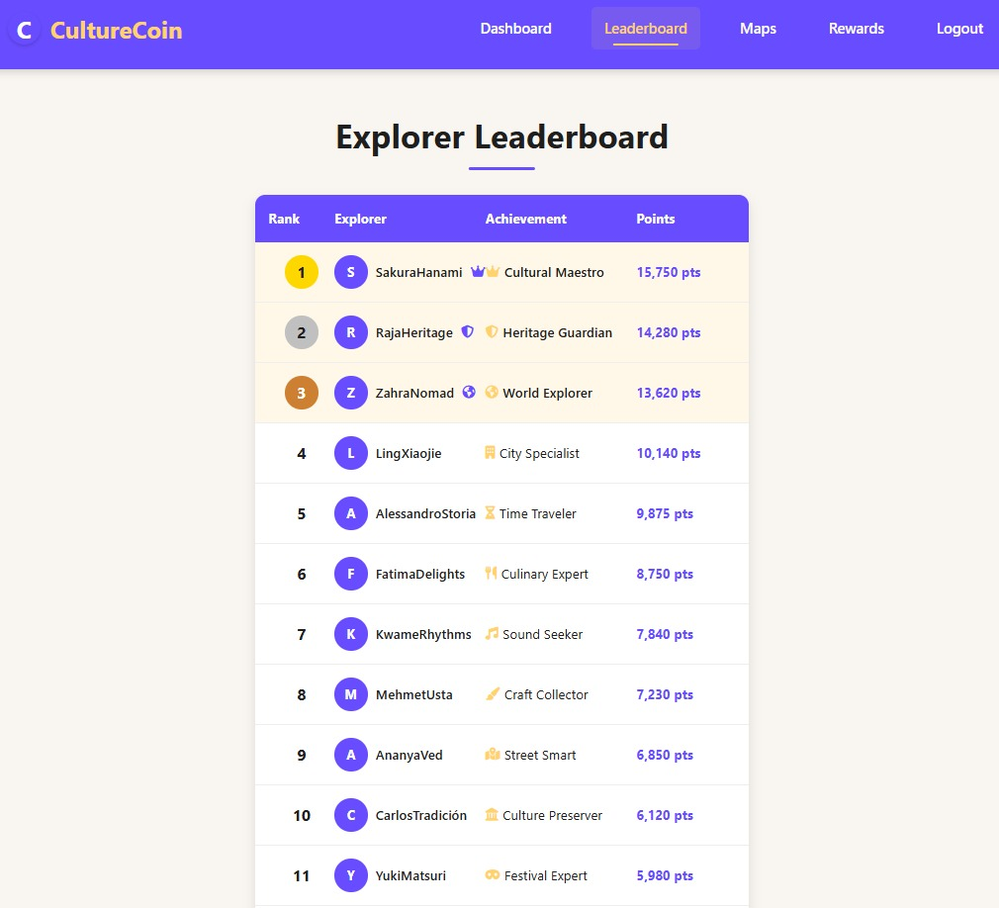
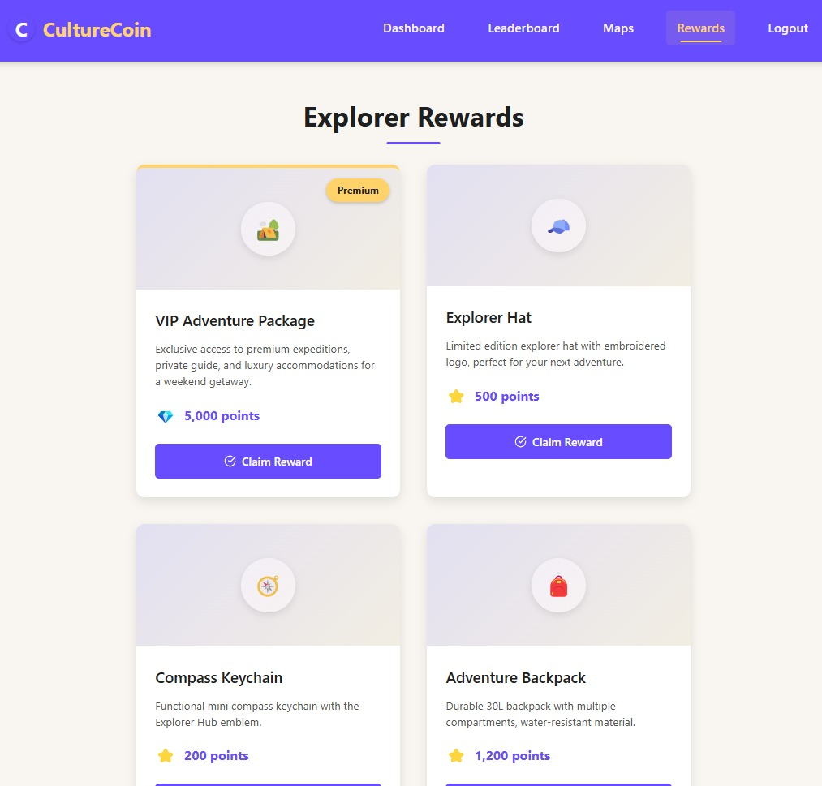
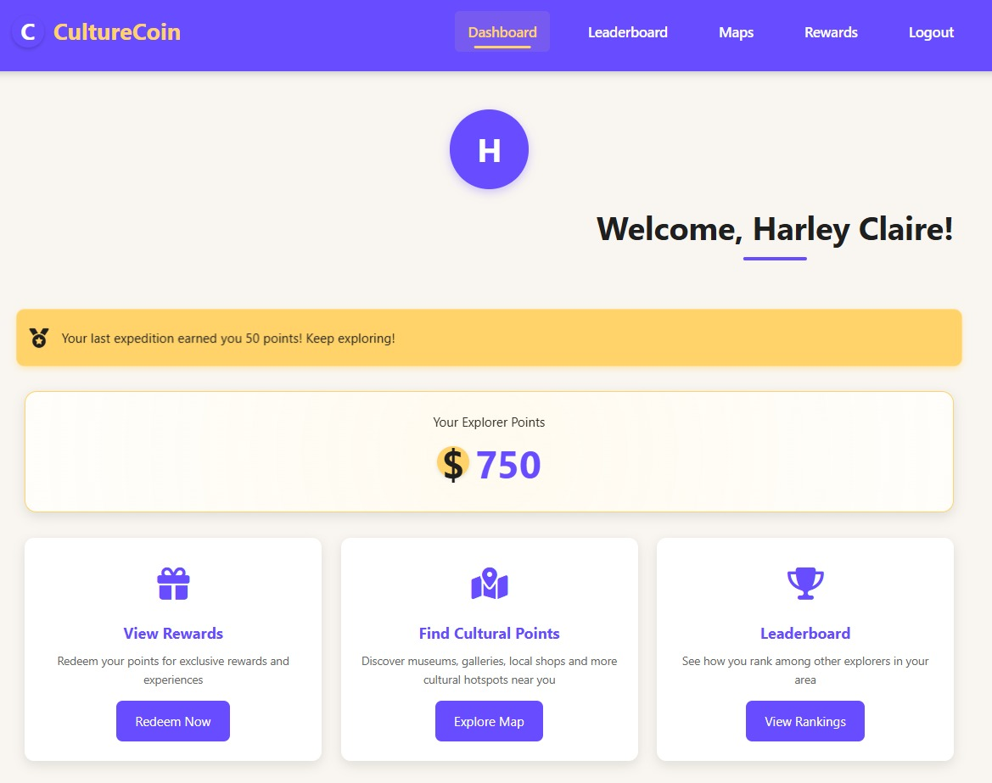

Snapshots:

Slide 20
Thankyou
Join us in reshaping how we interact with our cities, one CultureCoin at a time!!

